Slide 1
Seeing: pixels,
features and neurons
How can a machine read a picture when all it has is numbers?
Applied AI and Automation | Session 1 of 14
KLAi Professional Learning | Jotham Martin Wambi
Notes:
Welcome back. In Session 0 you saw the big picture: the types of AI, a model as a set of adjustable numbers called parameters, the training loop, gradient descent and backpropagation. Today we open the box, with a simple question: how can a machine read a picture when all it has is numbers?
For each idea I follow the same steps: an everyday example first, then the numbers, and then the standard name. By the end you will have opened a neuron up, worked one by hand and watched a small network learn to read handwriting, with real numbers from a real run.

Slide 2



Today in one view: what you will leave with
By the end of today you will have
Explain how a picture becomes numbers, in grey and in colour
Work a neuron by hand: weighted sum, bias and activation function, and say what the weights mean
Read the result of a small network that reads handwritten digits, including where it fails
Notes:
To answer that question, here is what you leave with. You can explain how a picture becomes numbers, in grey and in colour. You can work a neuron by hand, with its weighted sum, bias and activation function, and say what its weights mean. And you can read the result of a small network that reads handwritten digits, including where it fails.
The same thinking applies to a scanned invoice, an identity photo or a photo of stock in a depot. Nothing to submit, nothing to be tested on.

Slide 3
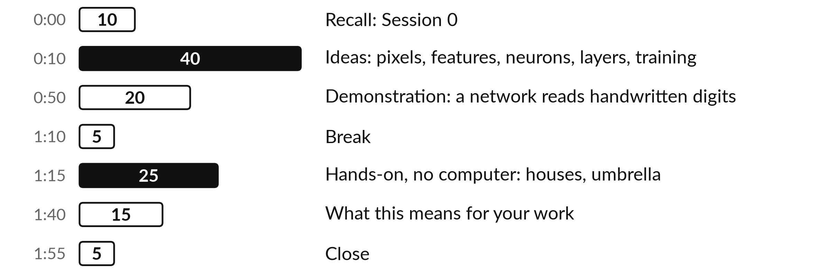
Your two hours: the ideas, a live
demonstration, and a paper exercise
No computer is needed from you. I run the demonstration and you watch, ask and join in.
Notes:
To get there in two hours, today has three big parts. First the ideas, about forty minutes: how a picture becomes numbers, what is inside a neuron, and how layers of neurons read a picture. Then a demonstration, about twenty minutes, where I train a small network on handwritten digits and you watch it learn.
After the break you work a neuron by hand on paper for twenty-five minutes: a house price, then an umbrella. Then fifteen minutes on what this means for your own work. Before any of that, a look at how today fits the course, and then five words.

Slide 4
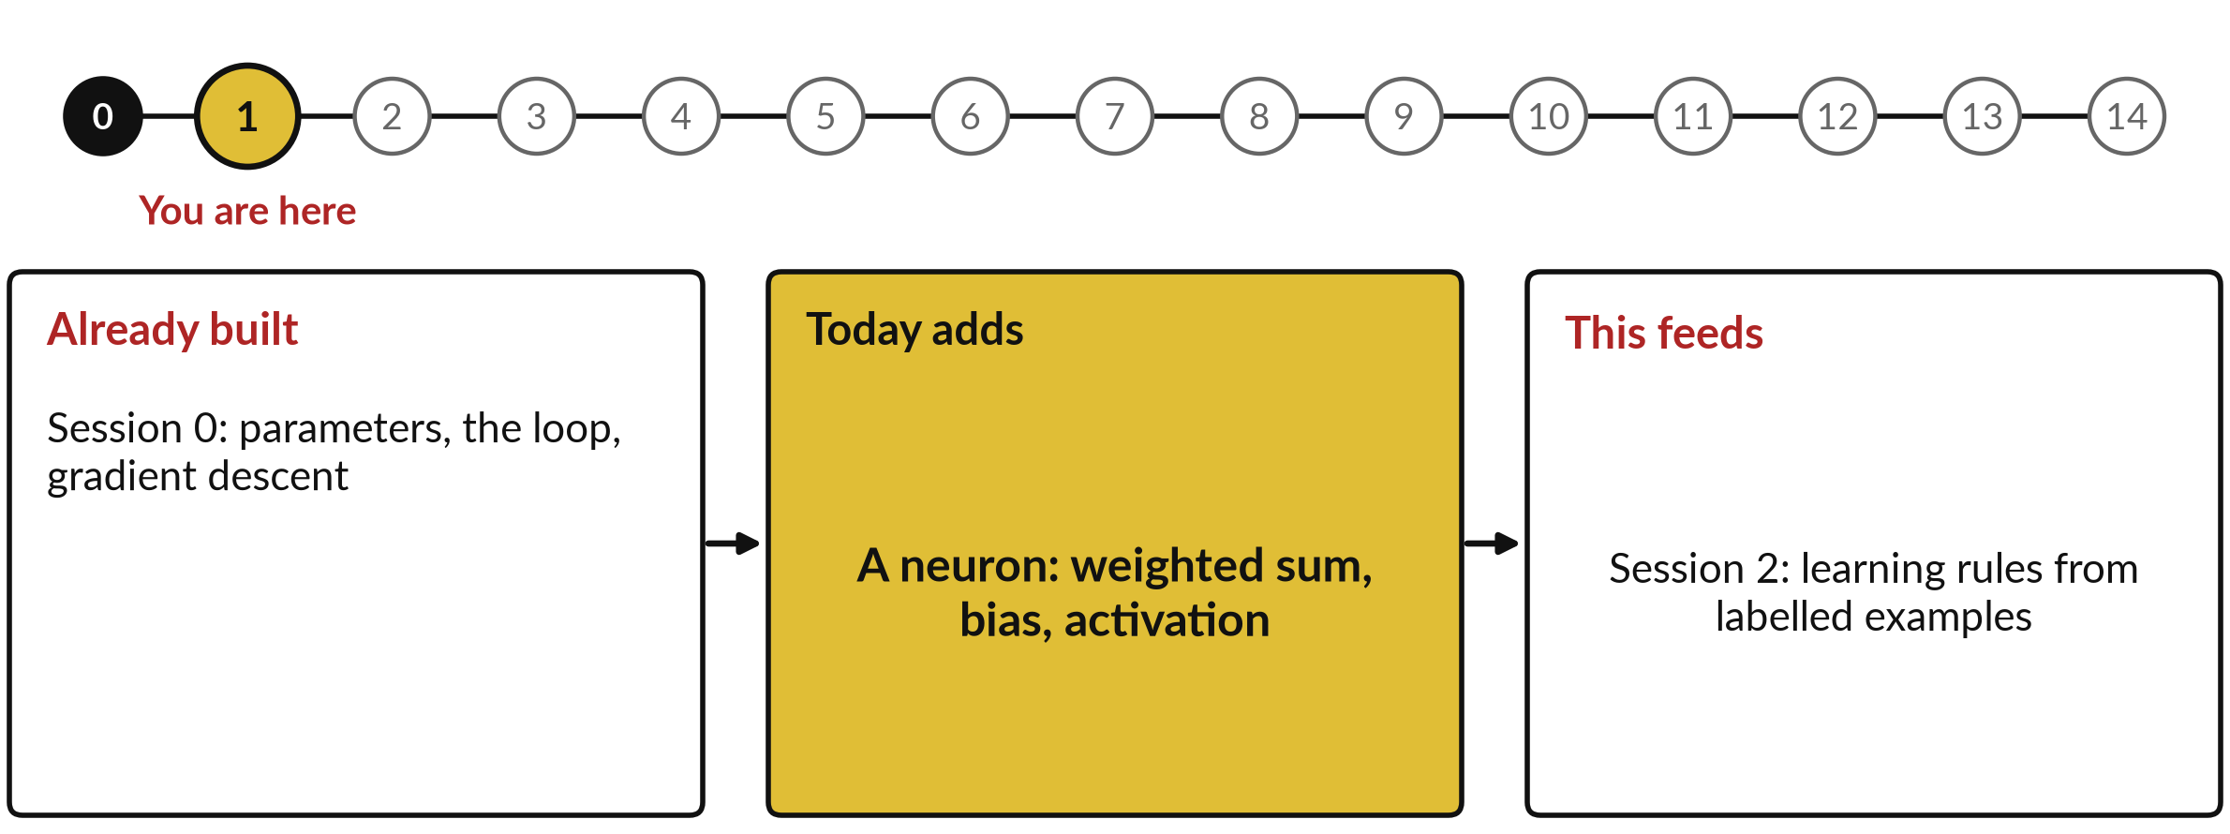
How today connects: what we
already have and what it feeds
Each session is built on the ones before it.
Notes:
So where does today sit in the story? The dots along the top are the fifteen sessions, from the map at Session 0 to your plan at Session 14, and the gold one is today.
We already hold parameters, the loop, gradient descent from Session 0. Nothing today starts from zero.
What today adds is this: a neuron: weighted sum, bias, activation.
And it feeds straight into what comes next. Session 2: learning rules from labelled examples. Keep that chain in mind, because each idea you learn today is a step on it.

Slide 5



Words we use today
Word | What it means
Pixel | One square of a picture, stored as a number (grey) or three numbers (colour).
Feature | An input measurement, such as the floor area of a house or the ink in the middle of a digit.
Neuron | A unit that computes a weighted sum of its inputs, adds a bias and applies an activation function.
Weight | A number that says how much one input counts. Training adjusts the weights.
Layer | A set of neurons that take the same inputs. Layers between input and output are hidden layers.
Notes:
Five words for today. I give the plain meaning of each, and we use every one of them before the end of the session.
Pixel. One square of a picture, stored as a number (grey) or three numbers (colour).
Feature. An input measurement, such as the floor area of a house or the ink in the middle of a digit.
Neuron. A unit that computes a weighted sum of its inputs, adds a bias and applies an activation function.
Weight. A number that says how much one input counts. Training adjusts the weights.
Layer. A set of neurons that take the same inputs. Layers between input and output are hidden layers.
Keep those words close. The first idea uses them straight away, so let us begin.

Slide 6
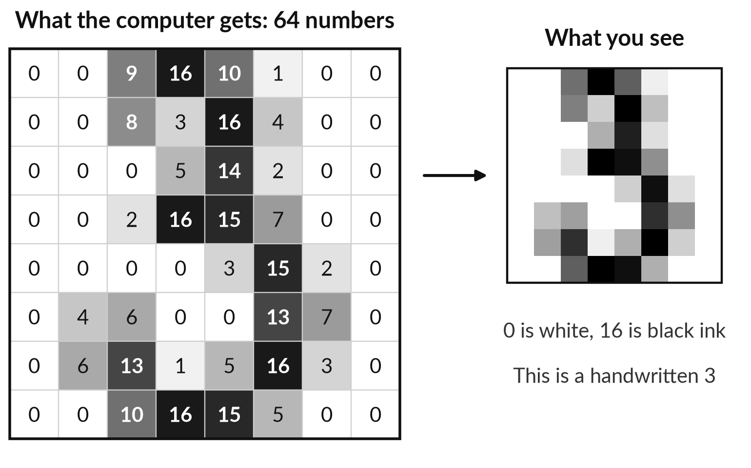
A picture is a grid of numbers,
one number for each square
The computer never sees a 3. It sees 64 numbers.
Each square is a pixel.
Here 0 is white and 16 is the darkest ink.
Think of a mosaic floor: every tile has one shade.
Notes:
The first word on that list was pixel, so let us see one. First the picture. On the right is a handwritten 3, and on the left is what the computer actually receives. The picture is an 8 by 8 grid, so 8 times 8 is 64 squares, and each square is one number from 0, white, to 16, darkest ink.
Now an everyday comparison: a mosaic floor in a hotel lobby, where every tile has one shade and from far away you see a pattern. A square of the picture is called a pixel. This is a real image from the digits set that comes with scikit-learn, a free data science library.

Slide 7
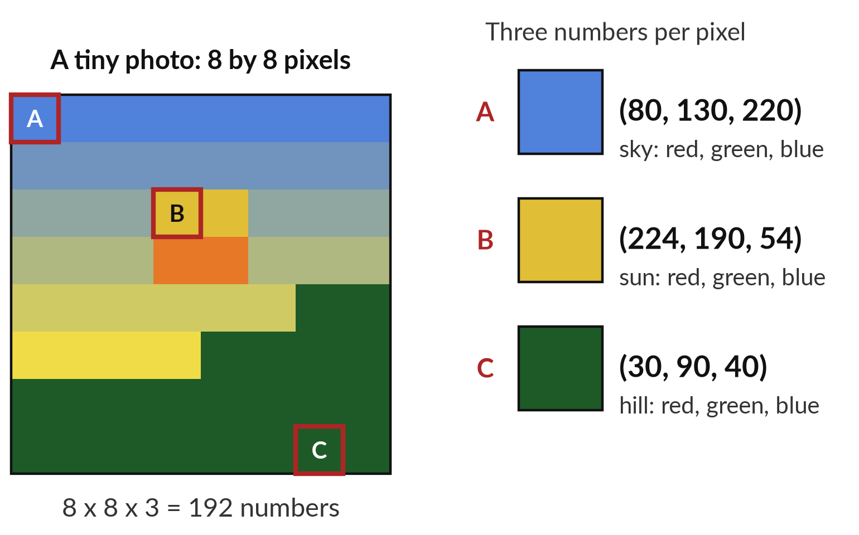
A colour pixel is three numbers:
how much red, green and blue
Mix three lights and you can make any colour on a screen.
Sky: (80, 130, 220). Sun: (224, 190, 54).
8 x 8 x 3 = 192 numbers for this tiny picture.
A 1,000 by 1,000 photo has 3,000,000 numbers.
Notes:
That picture was grey, and colour needs more numbers. First the everyday comparison. Imagine three torches shining on a wall, one red, one green, one blue, each with a brightness setting from 0 to 255. Turn all three high and you get white. Mix red and green and you get yellow.
So every pixel is three numbers, called RGB. Now the calculation. This tiny sunrise has 8 times 8 pixels times 3 numbers, which is 192 numbers. I drew it with a short script, so it is my own picture. A photo from your phone has millions of pixels. To keep it simple I leave out how files are compressed.

Slide 8
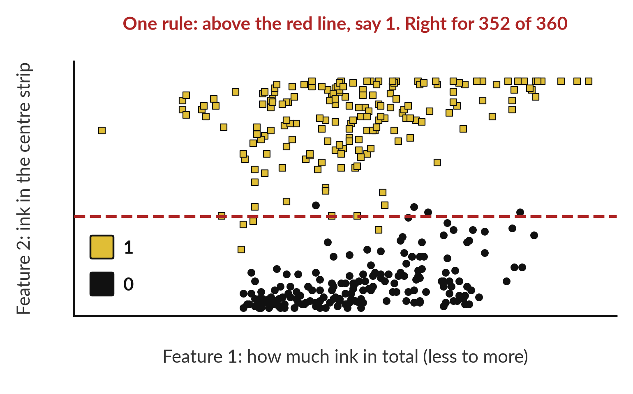
A feature is a measurement
taken from the picture
One measurement on a handwritten 0 and 1 already separates most of them.
Two features: total ink, and ink in the centre strip.
A person drew the red line: right 352 in 360.
Or the raw pixels: a network can take them directly, as you will see.
Notes:
Whether it is 64 numbers or 192, that is too many to reason about, so we take measurements. Here is an everyday example. An estate agent does the same: they do not describe every brick of a house, they quote the floor area and the number of bedrooms.
Those are features. Now the picture: I took two features from each handwritten 0 and 1: total ink, and the ink in the centre strip, where a 0 has a hole and a 1 has a stroke. One horizontal line on the second feature is right for 352 of 360 digits.
The numbers are from the 360 zeros and ones in the scikit-learn digits. Measurements like these, or the raw pixels themselves, are what a neuron works on, so let me show you a neuron.

Slide 9
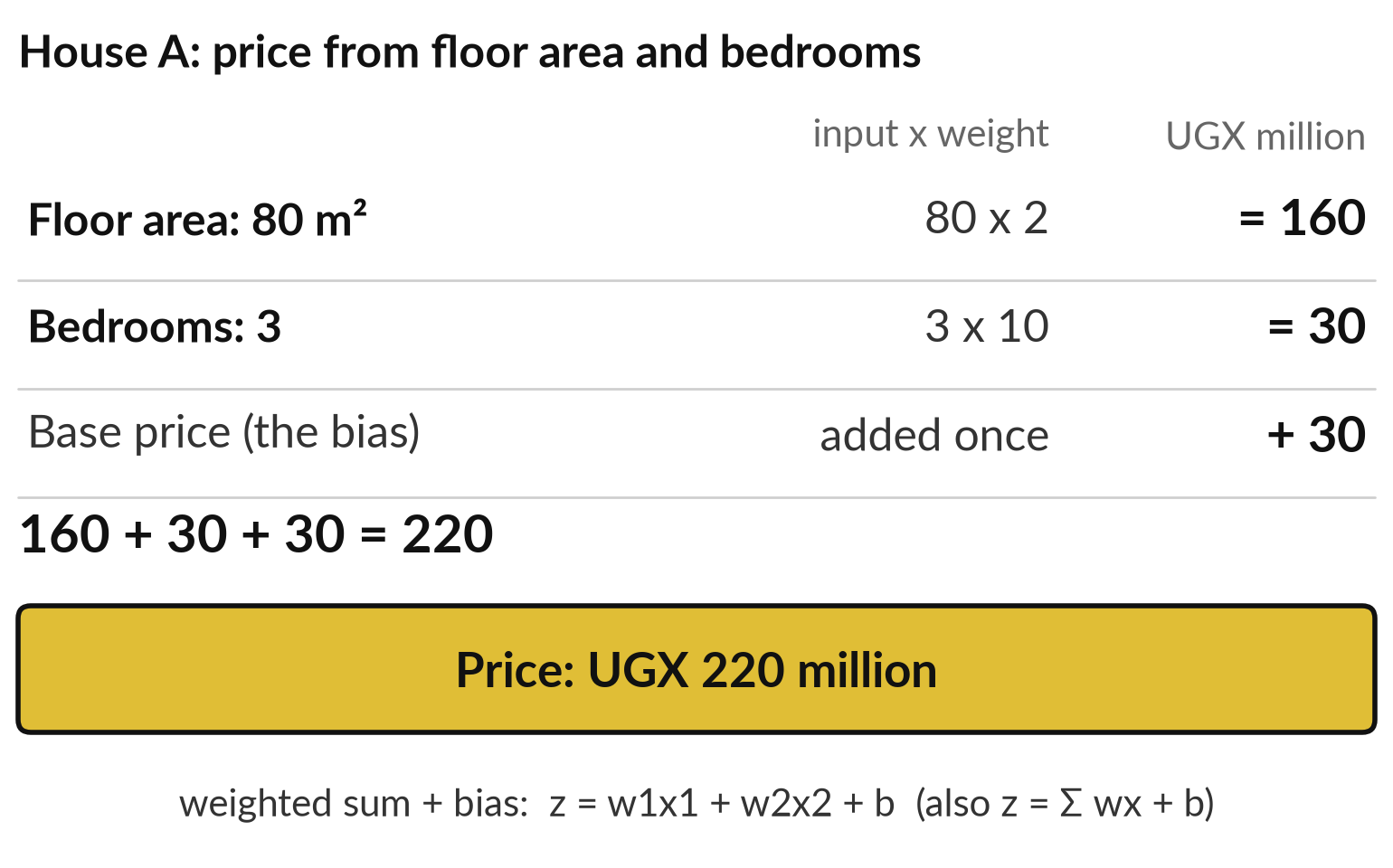
A weighted sum multiplies each input
by its weight and adds the results
Pricing a house from its floor area and bedrooms is a weighted sum.
The weights are prices per unit: UGX 2 million per m², UGX 10 million per bedroom.
The bias is the base price, added once: UGX 30 million.
Formula: z = w1x1 + w2x2 + b, the weighted sum.
Notes:
Now the idea behind everything today, and we start with something you already do: pricing a house. Suppose a house costs UGX 2 million for each square metre, UGX 10 million for each bedroom, and a base price of 30 million. Take 80 square metres and 3 bedrooms.
80 times 2 is 160, 3 times 10 is 30, and the base price adds 30, so the price is 220 million. In symbols, z equals w1 times x1, plus w2 times x2, plus b. The x values are the inputs, the w values are the weights, the price per unit, and b is the bias, the base price that shifts the result.
With many inputs it is written z equals the sum of w times x, plus b. In industry this is a weighted sum with a bias, and every neuron starts with it.

Slide 10

The same weighted sum prices three
houses: the weights decide the price
House | Floor area x 2 | Bedrooms x 10 | Bias | Price
A: 80 m², 3 bedrooms | 160 | 30 | 30 | UGX 220 million
B: 50 m², 2 bedrooms | 100 | 20 | 30 | UGX 150 million
C: 120 m², 4 bedrooms | 240 | 40 | 30 | UGX 310 million
Formula: z = w1x1 + w2x2 + b, also written z = w · x + b. A person chose these weights; training finds them from examples.
Notes:
Let us run the formula on three houses, by hand. A is the one we saw: 160 plus 30 plus the base 30 makes 220 million. B has 50 square metres and 2 bedrooms: 100 plus 20 plus 30 makes 150. C has 120 square metres and 4 bedrooms: 240 plus 40 plus 30 makes 310.
The weights here are prices per unit, and a person chose them. A different valuer might charge more for a bedroom. Written as a formula, z equals w dot x plus b. In a trained network, nobody chooses the weights: training finds them from examples, the loop you met in Session 0.
Before that, a neuron has one more part. It does not only give a price, it can make a decision.

Slide 11
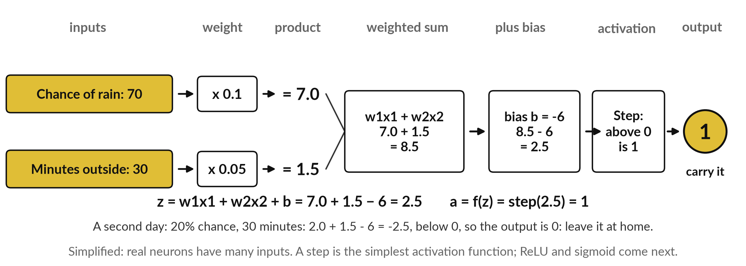
Open a neuron up: weighted sum, bias,
then an activation function that decides
Carry an umbrella? Output a = f(z), where f is a step: above 0 gives 1 (yes), otherwise 0.
Notes:
Now a decision instead of a price. Should you carry an umbrella?
Two inputs: the chance of rain, 70 per cent, and the minutes you will be outside, 30. The weights are 0.1 for each per cent of rain and 0.05 for each minute, so the products are 7.0 and 1.5 and the weighted sum is 8.5. The bias is minus 6: it sets how much evidence you need before the answer switches to yes.
8.5 minus 6 is 2.5. Call that total z. Last, the activation function f, applied to z: the output a equals f of z. This f is a step: above 0 the output is 1, carry it, otherwise 0. Weighted sum, bias, activation function: that is every neuron, from this toy to a language model. Real neurons have many inputs.

Slide 12
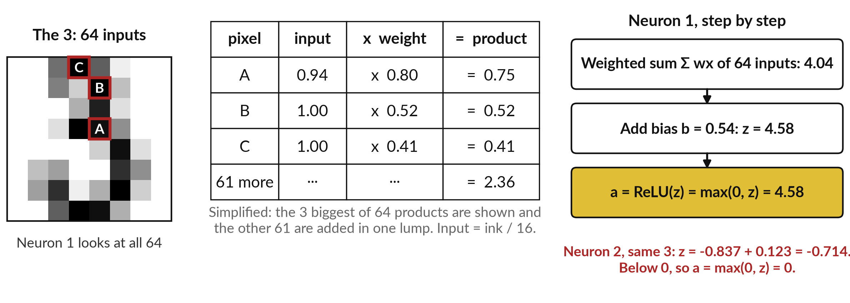
A real neuron from the digit network,
opened up on the handwritten 3
Recorded run, 5 November 2026. Recompute it with demo_runs/s01/neuron_peek.py.
Notes:
Now the same steps on a real neuron, neuron 1 of our trained digit network, looking at the handwritten 3. It has 64 inputs, one per pixel, each the ink divided by 16. I show the three biggest products. Pixel A is 0.94 times a weight of 0.80, which is 0.75.
B gives 0.52 and C gives 0.41. The other 61 pixels add 2.36, so the weighted sum of the 64 products is 4.04. Add the bias, 0.54, for a total of 4.58. The activation function is ReLU, the rectified linear unit: a equals the larger of 0 and z, so 4.58 stays 4.58.
Neuron 2, on the same picture, totals minus 0.71, so ReLU outputs zero. What I simplified: three of 64 products shown, the rest lumped together.

Slide 13
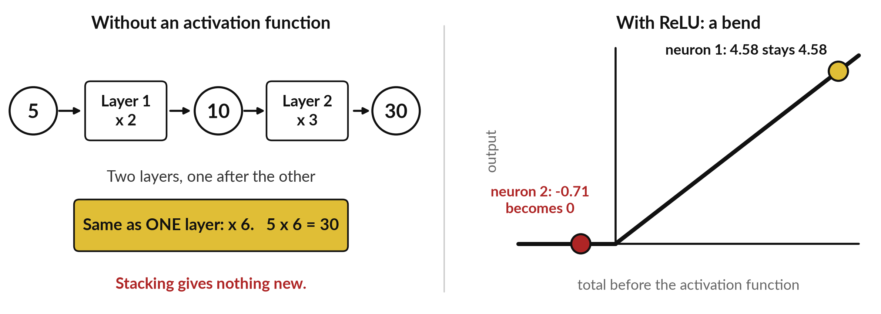
Without an activation function, stacked
layers collapse into one weighted sum
ReLU(z) = max(0, z). Sigmoid σ(z) = 1/(1 + e^(−z)) is smooth: σ(4.58) = 0.99 and σ(−0.71) = 0.33.
Notes:
You may ask why a neuron needs an activation function. Look at the left. Suppose layer one multiplies by 2 and layer two multiplies by 3. Five goes to 10, then to 30. But one layer that multiplies by 6 gives the same 30. Without an activation function, any number of layers collapses into a single weighted sum, so stacking would add nothing.
On the right is ReLU, a bend: below zero the output stays at zero, above zero it passes through. That bend adds non-linearity, which lets each layer build something new from the one before. Sigmoid is another common choice: one divided by one plus e to the power minus z, a smooth curve that squeezes any number into the range 0 to 1.
On the dots it gives 0.99 and 0.33. The dots are neurons 1 and 2 from before.

Slide 14
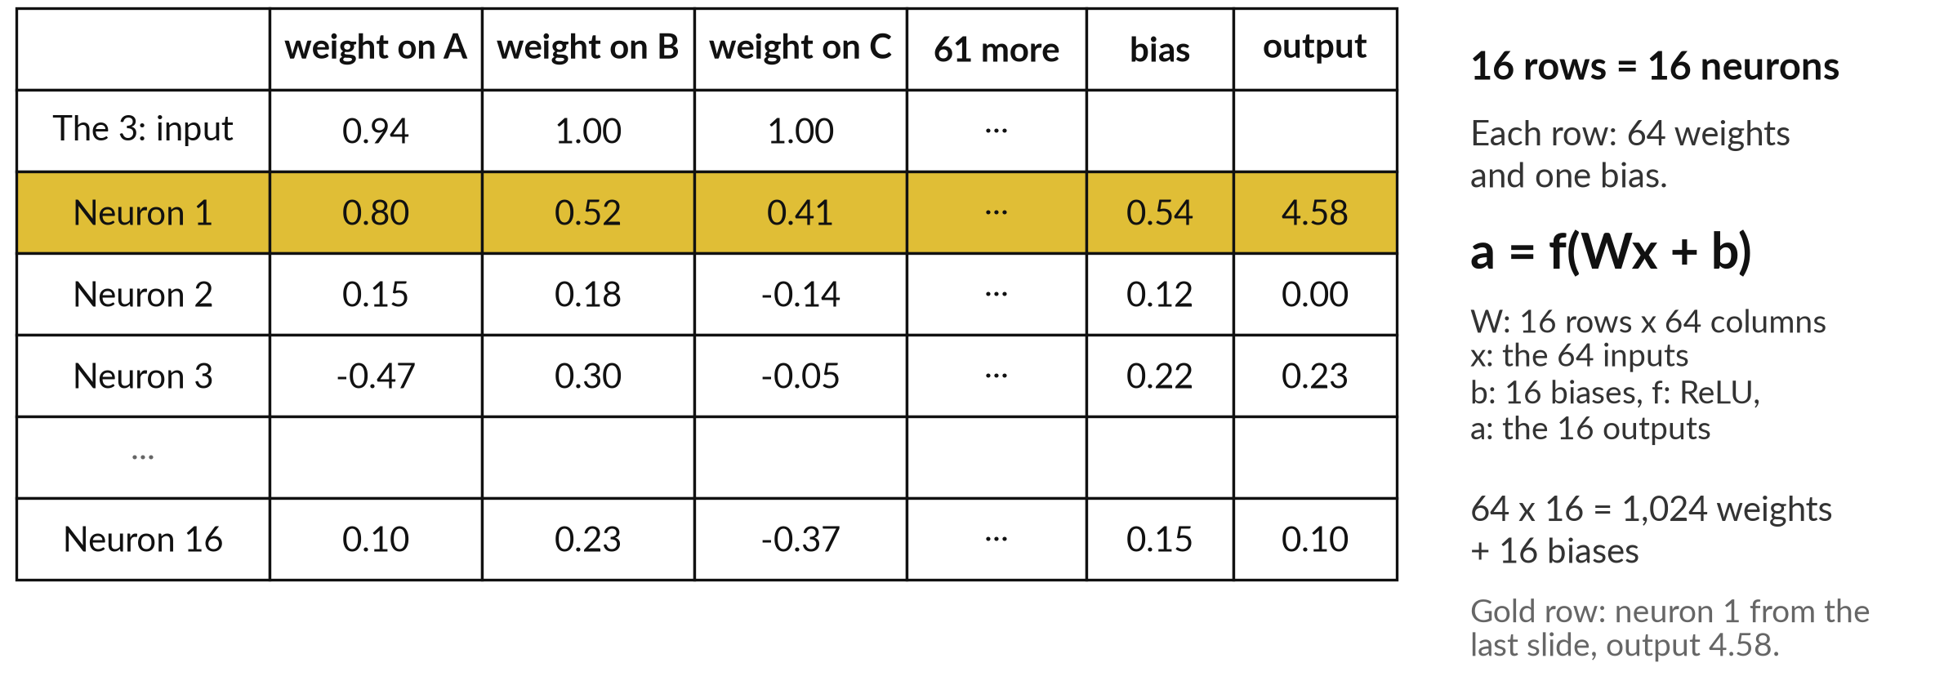
A layer is a table: 16 neurons
are 16 rows of weights
Recorded run. Three of the 64 weights shown. Industry form: a = f(Wx + b).
Notes:
One neuron is one row of weights and one bias. A layer is simply many rows, one for each neuron, all looking at the same 64 inputs. So here is the table. The top row is the 3 as inputs. Each row below is a neuron, with its weights on pixels A, B and C, then 61 more, then its bias, then its output after ReLU.
Neuron 1 is the gold row, 4.58 as before. In matrix form, a equals f of W x plus b: W has one row per neuron, x is the 64 inputs, b the 16 biases. So the layer does 16 weighted sums on the same inputs. These 16 neurons sit between the 64 inputs and the 10 outputs, so they form the hidden layer. That table of numbers is what training adjusts.

Slide 15
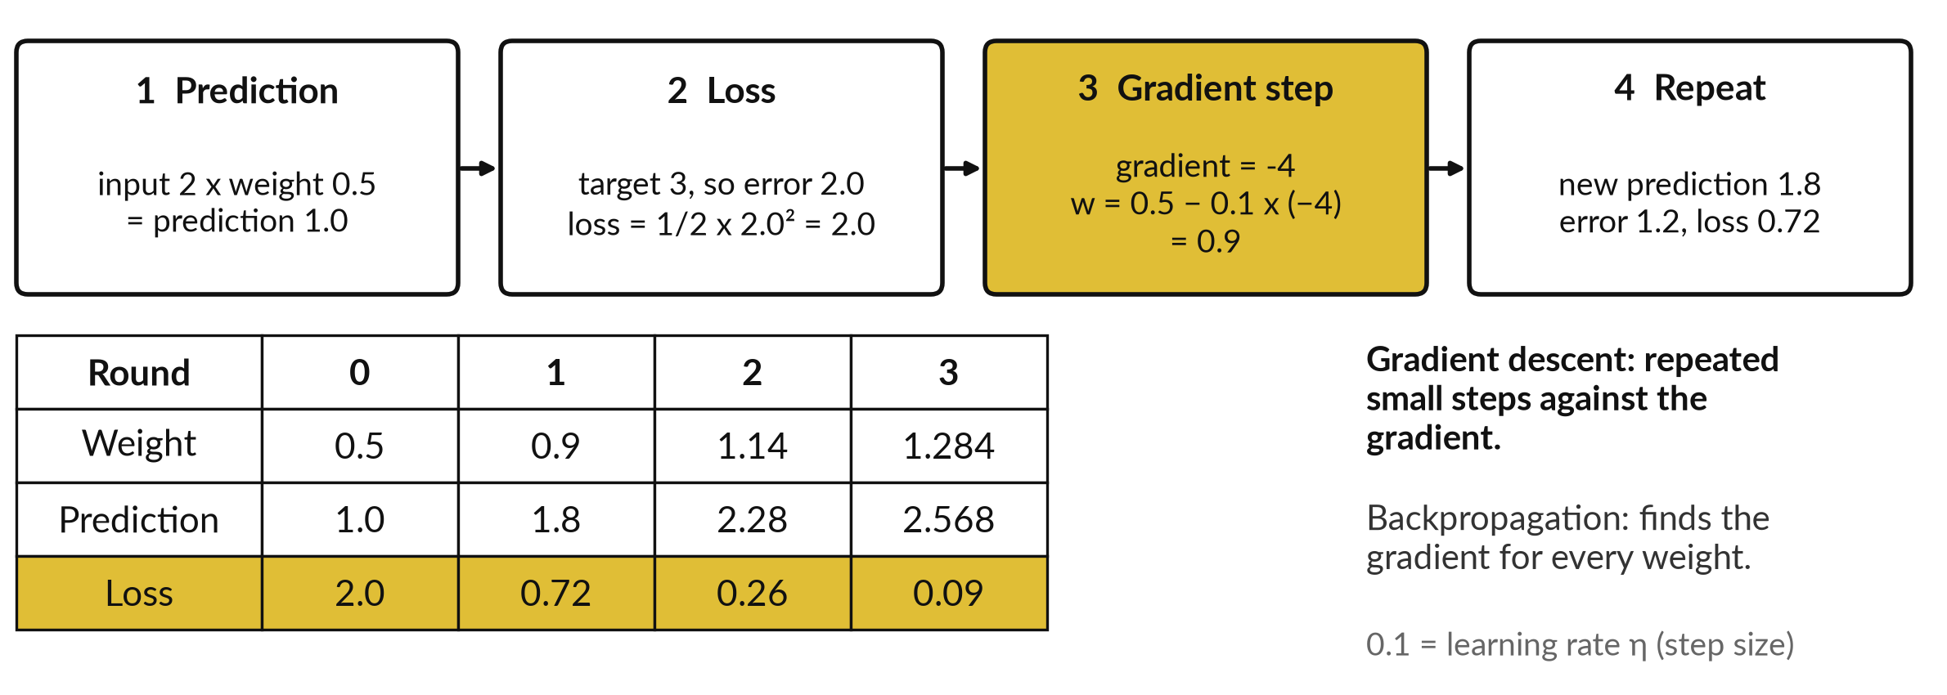
How one weight learns: loss, gradient
descent and the learning rate
A toy with one weight: the training loop of Session 0, with numbers.
Notes:
Now how does a weight get its value?
Take Session 0’s loop and apply it to one weight. The input is 2, the weight starts at 0.5, so the prediction is 1. The target is 3, so the error is 2. The loss function turns the error into one number to make small: here, half the squared error, which is 2.
The gradient says how the loss changes as the weight changes: minus 4, so raising the weight lowers the loss. Gradient descent steps against it, scaled by the learning rate, 0.1: 0.5 minus 0.1 times minus 4 is 0.9. The loss falls to 0.72, then 0.26, then 0.09. Next, the same steps as formulas.

Slide 16
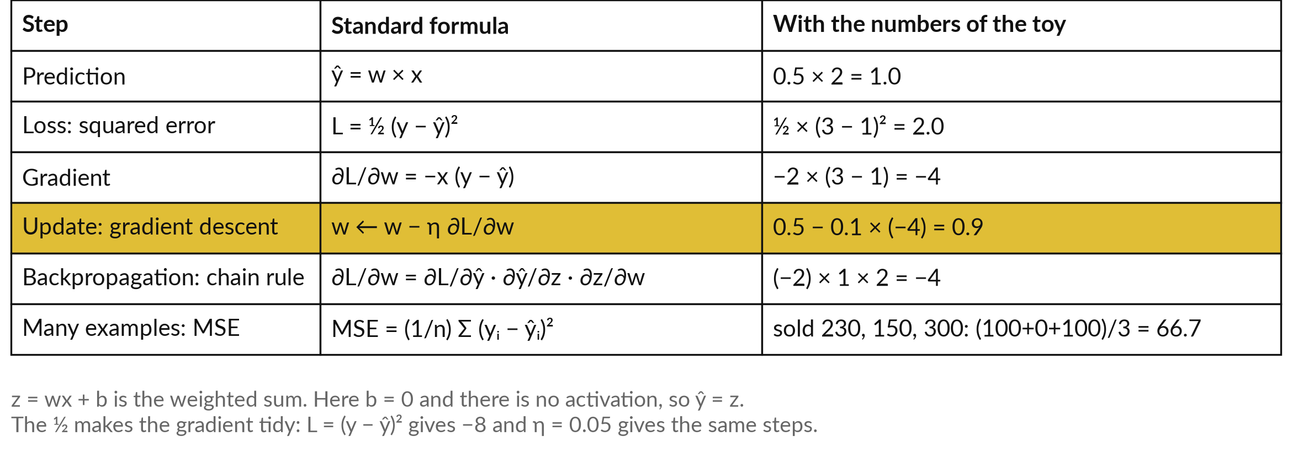
The formulas behind one learning
step, with the toy numbers
w weight, x input, y target, ŷ prediction, η learning rate, ∂L/∂w slope of the loss.
Notes:
The same steps as formulas. Prediction: y hat equals w times x. Loss: L equals a half times the error squared, which is 2. The gradient is the derivative, minus x times the error, which is minus 2 times 2, minus 4. The update, gradient descent: w new equals w old minus eta times the gradient, so 0.5 minus 0.1 times minus 4 is 0.9.
Backpropagation is the chain rule: the loss gradient is the product of three small slopes, here minus 2, 1 and 2. Over many examples the loss is the mean squared error. If three houses sell at 230, 150 and 300 against our 220, 150 and 310, the squared errors are 100, 0 and 100, and the mean is 66.7.
The half keeps the numbers tidy; without it a learning rate of 0.05 gives the same steps.

Slide 17
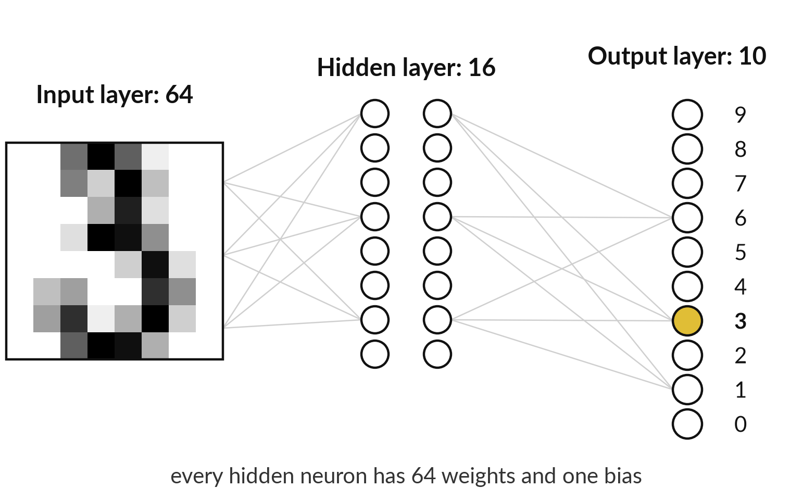
A network stacks layers: 64 inputs, a
hidden layer of 16 neurons, 10 outputs
The 16 neurons sit between input and output, so they form the hidden layer.
Each hidden neuron has 64 weights and a bias.
64 x 16 + 16 + 16 x 10 + 10 = 1,210.
All the weights and biases are the parameters.
Notes:
That update happens to every number in the network at once, so let us count them. Our digit network has an input layer: the 64 pixel numbers. The hidden layer has 16 neurons, each with its own 64 weights and a bias. It is called hidden because it sits between the input and the output.
The output layer has 10 neurons, one score for each digit 0 to 9. Count the parameters: 64 times 16 weights is 1,024, plus 16 biases, plus 16 times 10 weights is 160, plus 10 more biases. That is 1,210. Parameters are all the weights and biases of a model, the numbers training adjusts.
A large language model has billions, but the idea is the same.

Slide 18
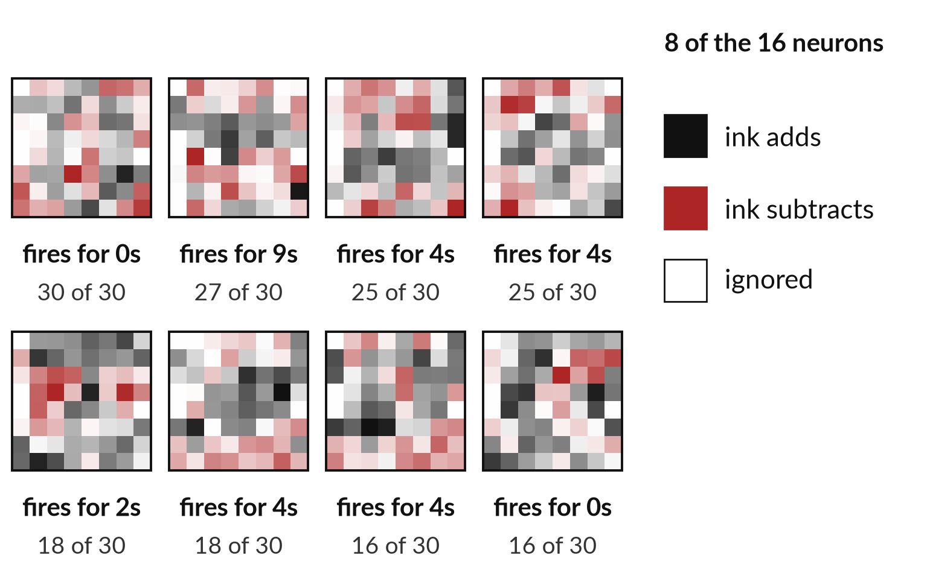
After training, each hidden neuron has
a favourite: one fires almost only for 0s
Look at what each neuron fires for.
Neuron 13: its 30 strongest images were all 0s.
Neuron 8: 27 of its 30 were 9s.
The weight pictures look messy. The behaviour is clearer.
Notes:
Here is a look at some of those numbers after training. These are the weights of eight of the sixteen hidden neurons, drawn as pictures: dark where ink adds to the score, red where it subtracts. They look messy. So I also asked a different question: which training images make each neuron fire hardest?
Neuron 13 fired hardest for 30 images and all 30 were zeros. Neuron 8 liked nines. Nobody told the network to look for a loop or a stroke. It found whatever lowered the error. Not every neuron is this neat, and that is why people say networks are hard to explain. This is a real run, recorded on 5 November 2026.

Slide 19
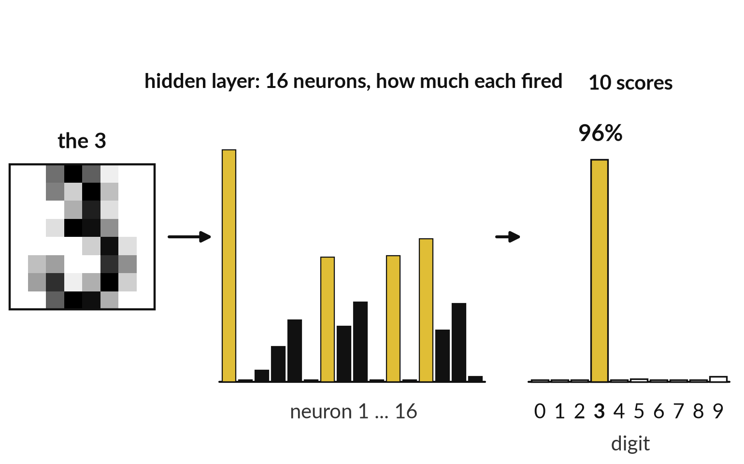
One image goes in, 16 hidden neurons
react, and the 3 wins with 96%
Gold bars are the neurons that fired strongly for this 3.
The hidden layer reacts to the pixels.
The output layer turns those reactions into 10 scores.
The scores add to 100%: the biggest is the answer.
Notes:
Those pictures show the neurons one at a time, so now follow one image through all of them. The 3 goes in. Each of the sixteen hidden neurons computes its weighted sum, adds its bias and applies ReLU, and the tall bars show how strongly each one fired.
A neuron whose total is negative stays at zero. Then the ten output neurons turn those reactions into ten scores, converted so that they add up to 100%. The conversion has a name, softmax, and we meet it again in Session 5. The score for 3 is 96%, and no other digit gets more than 3%. This is the answer, plus how sure the network is.

Slide 20
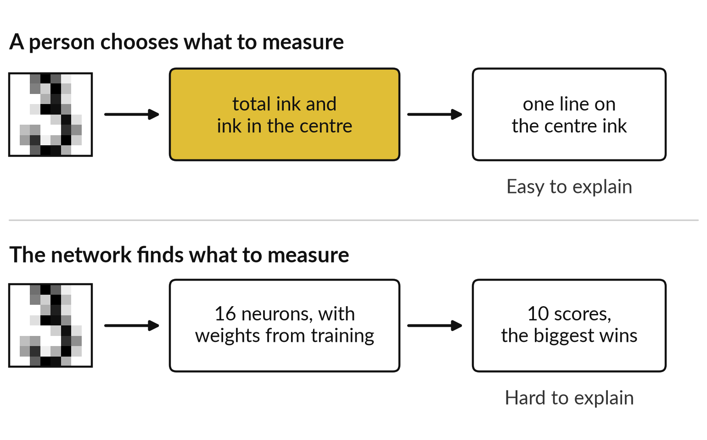
A person picks hand-made
features. A network finds its own.
Ask which one you can explain to a customer or a regulator.
Hand-made: easy to explain, suits narrow, steady tasks.
Learned: needs many labelled examples.
Learned: hard to explain in one sentence.
Notes:
That answer used no measurements that I chose, and that is the contrast I want to draw. You have now seen both ways. The feature scatter earlier used two measurements chosen by a person, and one line separated the digits well. The neuron results used no chosen measurements: the network found its own, from the examples.
Hand-made features are easy to explain and suit narrow, steady tasks, like checking a form layout. Learned features cope with messier pictures but need many labelled examples and are harder to explain. For your own work, the question is which one you could defend to a customer, an auditor or a regulator if they asked why a decision was made.
To see how a network arrives at its own features, we watch it train.

Slide 21
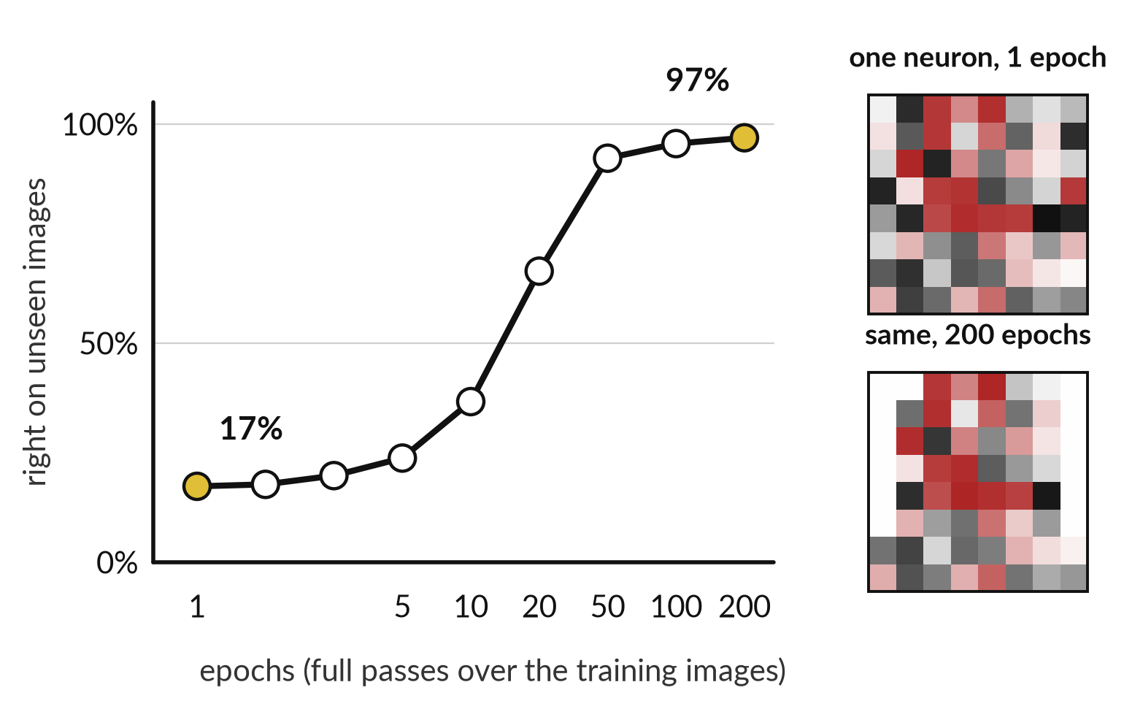
Training is the loop from Session 0: the
network is right more often each epoch
After 1 epoch it is close to guessing. After 200 it reads most digits.
Start: 17% right. Guessing among ten digits gives about 10%.
Each epoch: predict, measure the loss, adjust.
The same neuron looks different after training.
Notes:
How does the network arrive at those weights?
This is your training loop from Session 0, drawn from a real run. Each step adjusts every weight by gradient descent, as in the one-weight example. One epoch is one full pass over the training data, so after epoch 1 the network has looked at every training image once.
It is right 17% of the time on images it has never seen. Pure guessing among ten digits would give about 10%. After 20 epochs it is at 66%, after 50 at 92%, and after 200 at 97%. On the right, one neuron after 1 epoch and the same neuron after 200 epochs.
The weights have moved. That movement is the learning. Now I will run the whole thing for you.

Slide 22
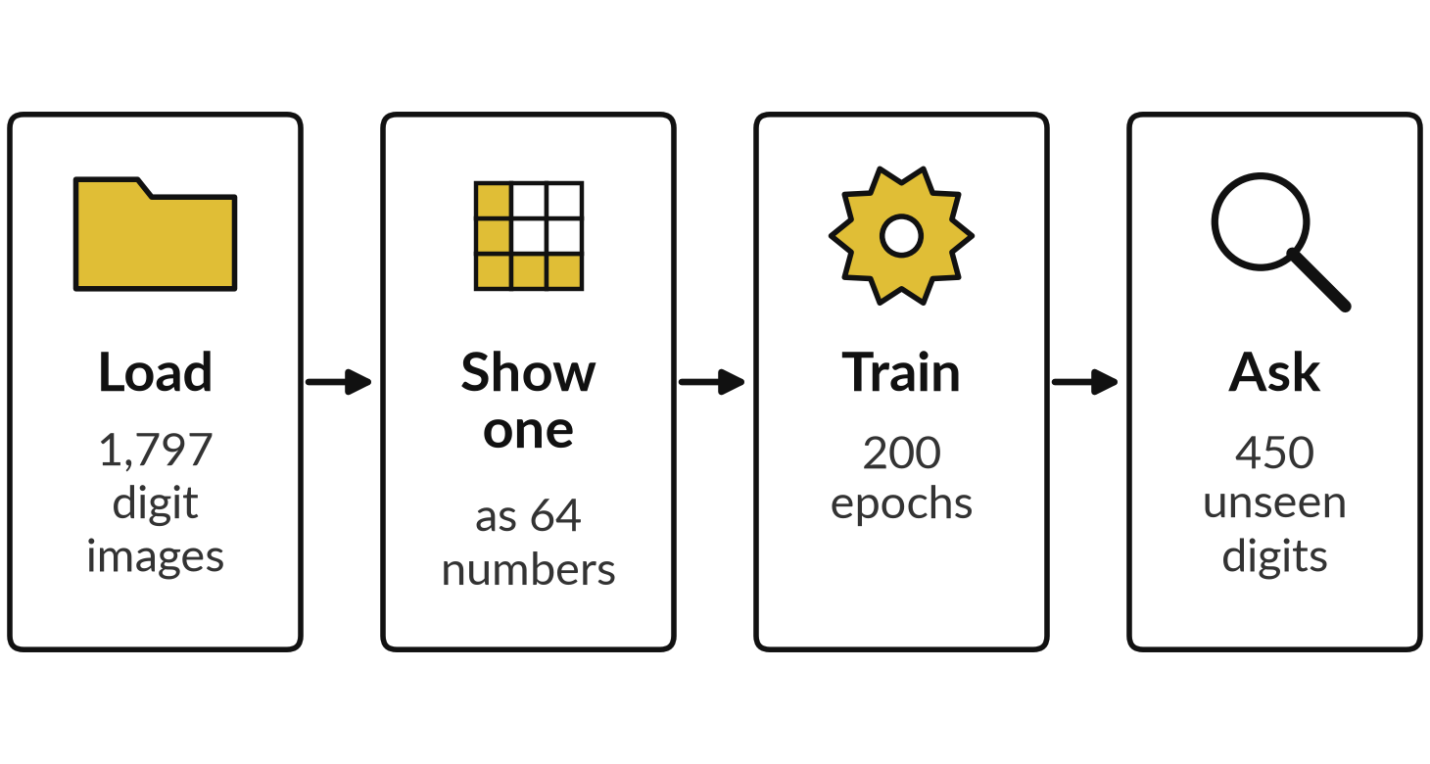
Demonstration: I train the digit
network and you watch it learn
I will show
Watch for
One image as plain numbers before any picture is drawn
The accuracy rising epoch by epoch
The mistakes, and which digits it confuses
Notes:
Rather than only describe it, I will do it in front of you. The script is called digits_run.py and it takes a few seconds on a laptop. First it loads the 1,797 handwritten digits that come with scikit-learn. It prints one image as 64 numbers. Then it trains the network with 1,347 images and holds back 450 that it never trains on.
Watch the accuracy on those 450 rise as the epochs go up. The script prints epochs as passes. Then we look at the mistakes. The same script produced every number on today’s slides, in a recorded run on 5 November 2026. If it fails on the day, I show the saved output.

Slide 23
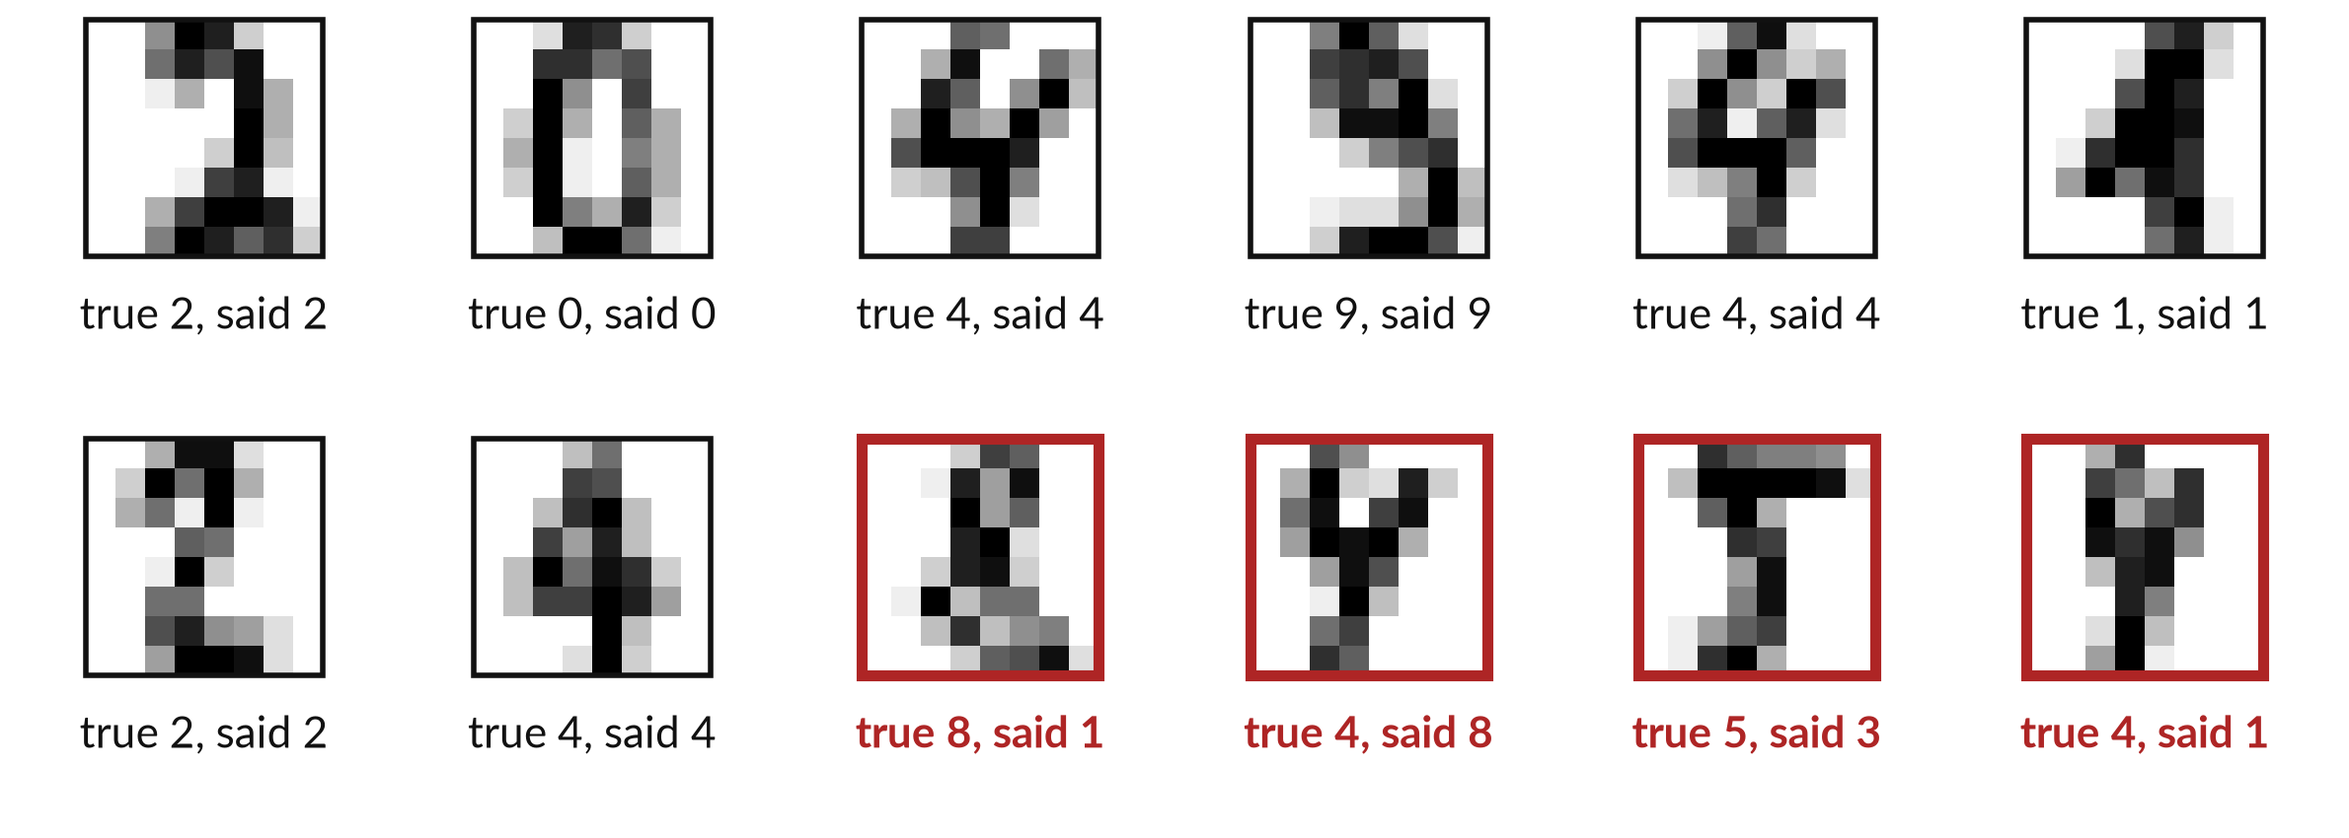
Recorded run: 436 of 450 unseen digits
right, 97%, with the first 4 mistakes in red
Recorded run, 5 November 2026. Five random starts: 96% to 97%. Mistakes in red.
Notes:
What did you see as the accuracy climbed?
Now the finished network on 450 images it never trained on. The first eight test images are all right. The four red frames are the first four of fourteen mistakes, and a person would struggle with some: that 8 really does look like a 1. In total 436 of 450 are right, which is 97%.
Five training runs from different random starts all landed between 96% and 97%, so the result is steady. But these are tidy 8 by 8 digits, and the network never says I do not know. Real handwriting is harder, and Session 3 shows how to measure properly.

Slide 24
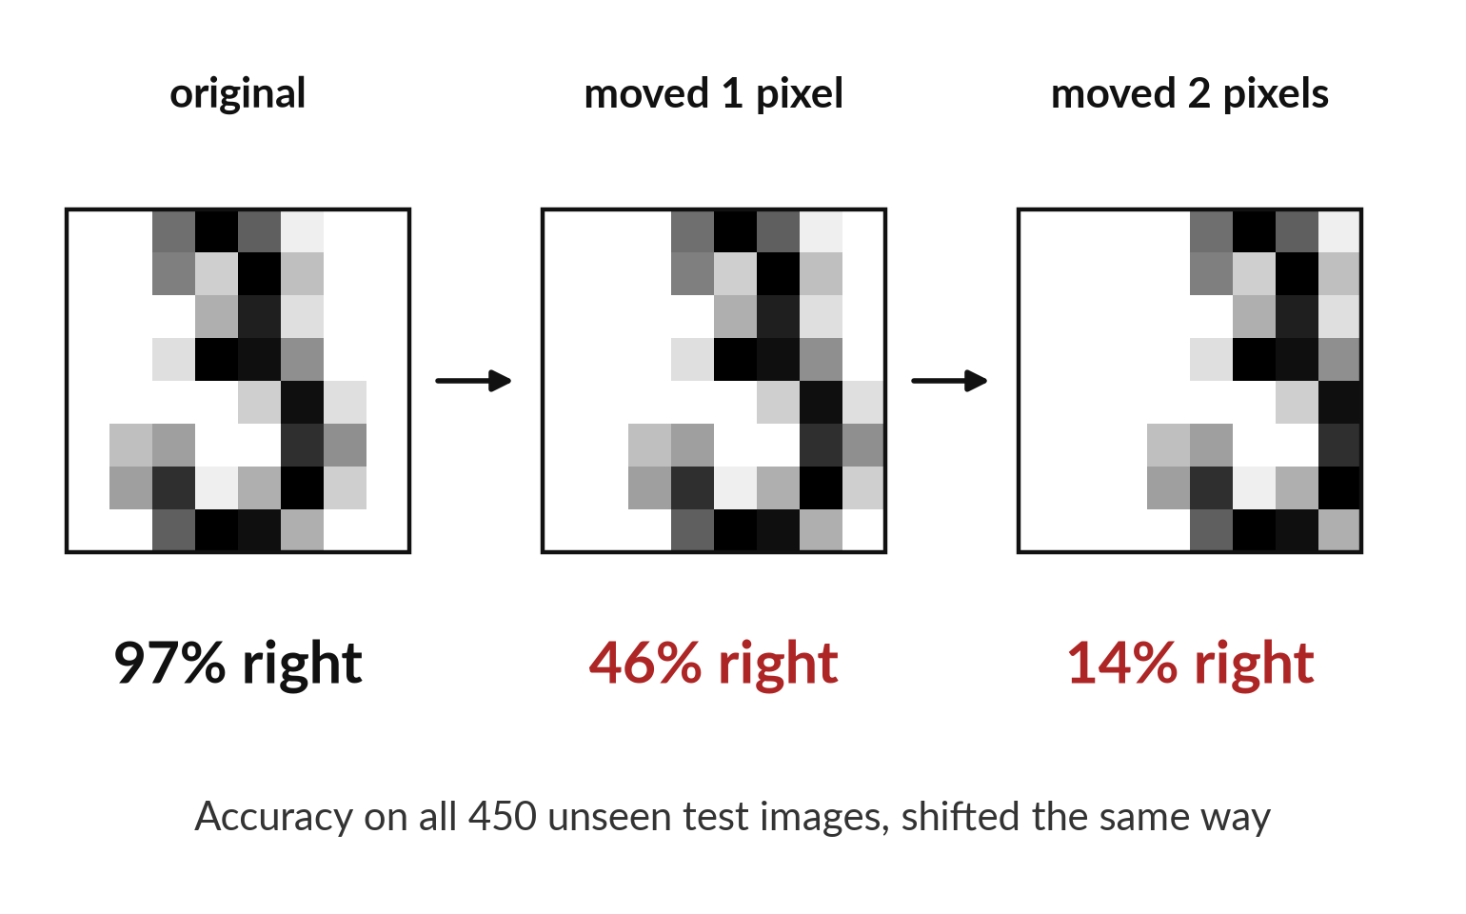
Move the digit one pixel and
the same network falls to 46%
It learned pixel patterns in fixed places.
Training digits were centred. Shifted ones were never seen.
A person reads a shifted 3 at once.
A model is only as good as the cases it saw.
Notes:
So the 97% was on digits sitting exactly where the network expects them. Here is the limit. I took the same 450 test digits and slid each one a single pixel to the right. Accuracy fell from 97% to 46%. Two pixels, and it falls to 14%. A person would read all three pictures as a 3 without noticing the difference.
This small network learned patterns of dark pixels in fixed places. Networks built for pictures, called convolutional networks, are designed to cope with shifts much better, so do not conclude that all image systems are this fragile. Do conclude that you must test a system on the pictures it will really meet.

Slide 25






Reading images appears in every function:
what goes in, what comes out, what you check
Function | Picture in | Answer out | What a person checks
Finance | Scanned supplier invoice | Supplier, date, total | Total against the order
HR | Photo of a certificate | Name and dates read | Anything flagged as odd
Operations | Photo of stock in the depot | Count of bags | A sample count by hand
Compliance | Scanned signature page | Signed or blank | Every page flagged blank
Legal | Scanned court bundle | Readable text | Misread names and figures
Sales | Photo of a shop shelf | Product present or missing | Photos taken in poor light
These are uses of the same family of technique, with larger networks. Test each on your own images.
Notes:
That lesson, test on the pictures you will really meet, applies in every function. Here is where it shows up in your own work. In finance, a scanned invoice goes in and a supplier, date and total come out. In HR, a photo of a certificate. In operations, a photo of stock in the depot, and a count of bags comes back.
In compliance, a signature page, and the answer is signed or blank. In legal, a scanned court bundle becomes text, and names and figures can be misread. In sales, a photo of a shelf. These use bigger networks from the same family. The last column matters most: what would a person check, and how would you know the system works on your images? After this you do the calculation yourself.

Slide 26
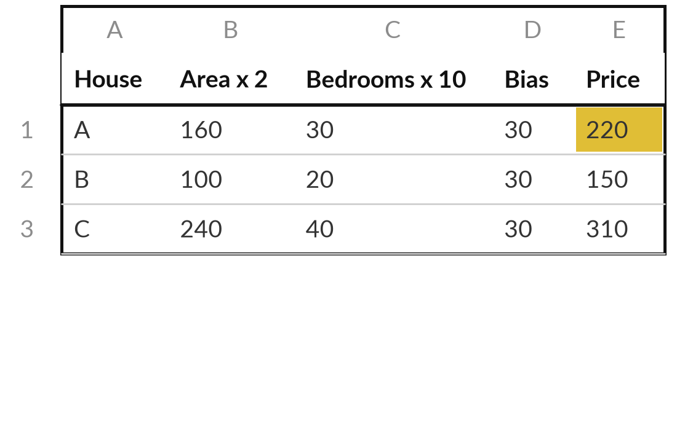
Price five houses, then decide
on five days with a neuron
25 minutes
Hands-on, no computer
Work through the one-page worksheet: five houses, then five days of weather.
Price each house: area x 2 + bedrooms x 10 + bias 30.
Make a bedroom weigh 15. How does each price move?
Each day: 0.1 x rain + 0.05 x minutes - 6. Above 0, carry an umbrella.
Change the bias to -7. Which day changes?
You keep: Five prices, five decisions and one sentence on what a weight and a bias do.
Notes:
Now it is your turn to do the calculation. This is the paper exercise, twenty-five minutes, no computer, and I walk round while you work. Part one has five houses. Price each one: floor area times 2, plus bedrooms times 10, plus the bias of 30. Then change the weight of a bedroom from 10 to 15 and see how each price moves.
Part two has five days of weather, each with a chance of rain and the minutes you will be outside. Work out 0.1 times the rain, plus 0.05 times the minutes, minus 6, and apply the step: above 0, carry an umbrella. Then change the bias to minus 7 and find the day that changes.
You are doing what training does: adjusting a parameter and watching the results move.

Slide 27




Where would a system that reads
pictures help or hurt in your work?
Pick one place in your job where pictures or scans are read by people today. What should happen?
Use it now
Use it with a checker
Wait
Do not use it
Low cost of a mistake, and a person can check quickly
A person reviews every flagged case
Our images are poor or unusual: test first
A mistake costs too much to catch
Write your decision and the reason in your workbook.
Notes:
That exercise was a small version of what training does, and now I want to turn it to your own work. You have fifteen minutes. Think of one place in your job where a person reads pictures or scans today: invoices, identity documents, photos of goods, signed pages.
Which of these four fits?
Use it now, if a mistake is cheap and a person can check quickly. Use it with a checker, if every flagged case is reviewed. Wait, if your images are poor or unusual and you need to test first. Do not use it, if a missed mistake costs too much.
Tell me your choice and the reason. The reason matters more than the choice.

Slide 28
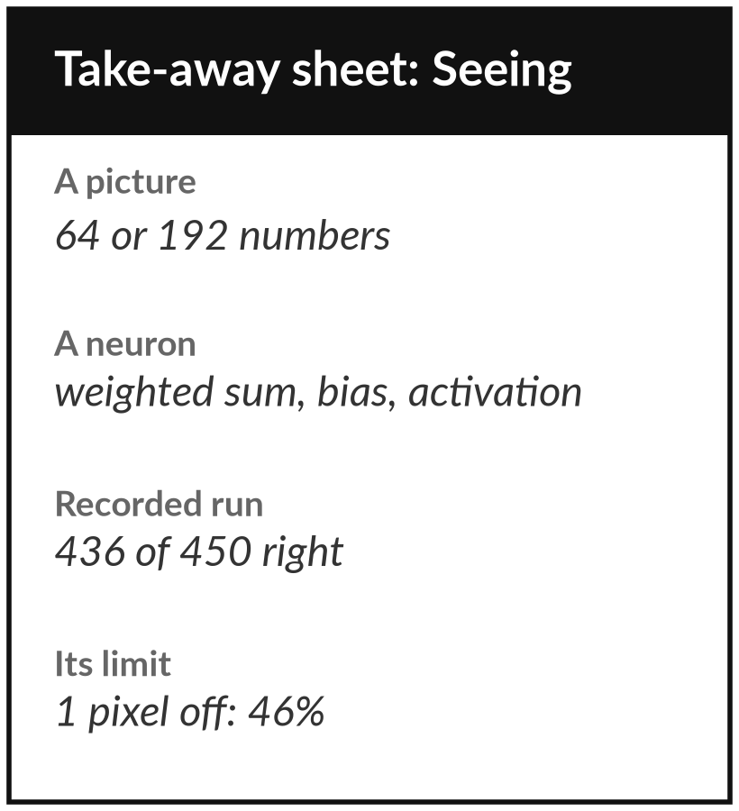
Keep the sheet: it is the
whole session on one page
What you keep from today
A one-page sheet: how a picture becomes numbers, a neuron worked by hand on a house price and an umbrella, and the digit results.
Our question today
How can a machine read a picture when all it has is numbers?
Next session
Session 2: Learning from examples: types of machine learning, decision trees, nearest neighbours.
Notes:
Keep the one-page sheet. It has the neuron worked by hand on a house price and an umbrella, the numbers from today’s run, and the one limit to remember: a network is good at what it has seen. If you use any system that reads images or scans in your work, ask what it was trained on and how it was checked.
In Session 2 we ask the next question: how does a machine learn a rule from examples, and how much can you trust what it learned?
We began with this question: How can a machine read a picture when all it has is numbers? Before you go, say in one sentence what you can now say about it.

